Slide 1
D-Stress Portal
Army Institute of Technology
Team Name : dumb_terminals

Slide 2
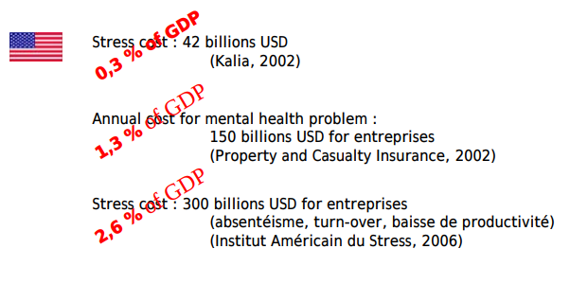
Source : WHO Study

Slide 3
Problem Statement
Mental Stress is a serious issue which can degrade an employee’s productivity and performance, impact your physical and emotional health, and affect your relationships and home life. It can even determine success or failure on the job.
To build a portal where HR Manager can check and see whether particular employee needs mental stress treatment or not.

Slide 4
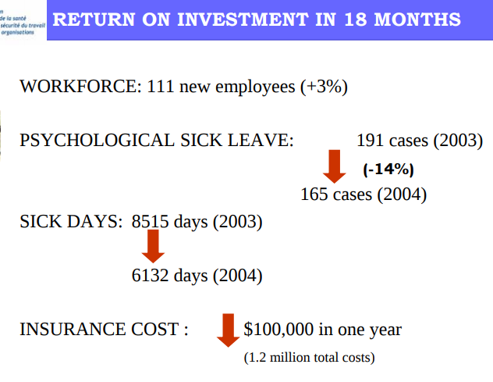
Source : WHO Study

Slide 5
Solution Proposed
We have built a portal where an HR Manager can search the employees his/her credentials or employee id and check whether he/she requires treatment or not.
We basically predict a probability whether treatment is required or not and then its HR Manager’s call to approve him/her for any stress relief packages to reduce stress.
If HR Manager approves the leave then the employee is notified via instant mail service informing him about the stress-relief package.
We’ve also added a feedback loop to increase performance of model over time based on feedback from HR Manager.

Slide 6
Modelling - 1
Removed features:
Date_time
Country
State
self_employed
Preprocessing :
Various Gender values are binned into three bins i.e Male, Female, Trans.
Cleaned outliers in Age feature. ( < 0 and > 100)

Slide 7
Modelling - 2
Feature Engineering :
Textual Features :
Comment polarity, subjectivity using TextBlob
Basic text features like count, unique_word_count, length of text, etc
TF-IDF Vectorizer + TruncatedSVD (compressed to 25 features)
Binned Age feature
Model Used :
Baselined almost all machine learning models out of which boosting algorithms excelled.
LightGBM scored 90.3 (Leaderboard) and a binary error of (~0.1) locally.
Hypertuned LGB and used some tricks to get a minor increase on accuracy.

Slide 8
DEMO

Slide 9
Future Scope
Feedback loop - integration
Survey details filling
Reports on basis of whole organization

Slide 10





Tech Stack
Azure :
VM
Load Balancer
Nodejs
Flask
Python

Slide 11
Thank You!

